Slide 1
IoT- Introduction
IoT stands for Internet of Things.
It refers to a network of interconnected devices embedded with sensors, software, and other technologies that enable them to collect and exchange data over the internet.
These devices can range from everyday objects such as household appliances, wearable devices, and industrial machines to vehicles and infrastructure components like smart grids and smart cities.
The key concept behind IoT is the ability of these devices to communicate with each other and with centralized systems, often referred to as the "cloud” (Store, analyse, monitor, decision)
IoT application is seen in various domains, including home automation, healthcare, agriculture, manufacturing, transportation, and more.

Slide 2
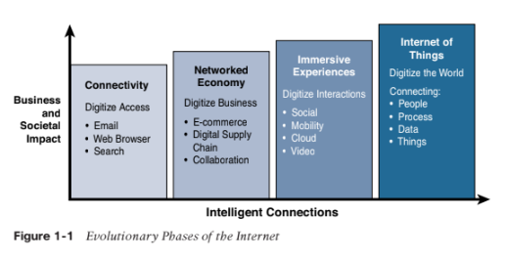
Genesis of IoT
The person credited with creation of the term “IoT” is Kevin Ashton.
20th Century- Computers were brain without sensors- input data and knowledge
21st Century- Brain with sensors-themselves.
Evolutionary Phases of IoT:
Connectivity
Networked Economy
Immersive Experiences
Internet Of Things

Slide 3
Internet Phase | Definition
Connectivity (Digitize Access) | This phase connected people to email, web services and search, so that information is easily accessed.
Networked Economy (Digitize Business) | This phase enabled e-commerce and supply chain enhancements along with collaborative engagement to drive increased efficiency in business.
Immersive Experiences (Digitize Interactions) | This phase extended the Internet Experience to encompass widespread video and social media while always being connected through mobility. More and more applications are moved to Cloud.
Internet of Things (Digitize the World) | This phase is adding connectivity to Objects and machines to the world around us to enable new services and experiences. It is connecting the unconnected. . 15
Internet Phase | Definition
Connectivity (Digitize Access) | This phase connected people to email, web services and search, so that information is easily accessed.
Networked Economy (Digitize Business) | This phase enabled e-commerce and supply chain enhancements along with collaborative engagement to drive increased efficiency in business.
Immersive Experiences (Digitize Interactions) | This phase extended the Internet Experience to encompass widespread video and social media while always being connected through mobility. More and more applications are moved to Cloud.
Internet of Things (Digitize the World) | This phase is adding connectivity to Objects and machines to the world around us to enable new services and experiences. It is connecting the unconnected. . 15

Slide 4
Internet Phase: first Phase | Connectivity(Digitize Access)
Began in the mid 1990s. Email and getting Internet were luxuries for universities and corporations. Dial-up modems and basic connectivity were involved. Saturation occurred when connectivity and speed was not a challenge. The focus now was on leveraging connectivity for efficiency and profit.
4

Slide 5
Internet Phase: Second Phase | Networked Economy (Digitize Business)
E-Commerce and digital supply chains become the rage. E-commerce refers to the buying and selling of goods and services over the internet. Vendors, Suppliers and Consumers became closely interlinked. Online Shopping experienced incredible growth . The economy become more digitally intertwined as suppliers, vendors and consumers all became more directly connected. Supply chain Visibility and planning -machine learning, and AI algorithms to predict demand patterns
5

Slide 6
Internet Phase: Third Phase | Immersive Experiences (Digitize Interactions)
Immersive Experiences, is characterized by the emergence of social media, collaborations and widespread mobility on a variety of devices. Social Media Interactions (text based communication/Real time chat/Social Networking) Video Platform Interactions: (Content creation and sharing/ Live streaming/ Conference-collaborative viewing) Mobile Apps and Platforms (Public transit and digital payments/Digital ticket validation/Ride sharing )
6

Slide 7
Internet Phase: Forth(last) Phase | Internet of Things (Digitize the World)
We are in beginning of the IoT phase. 60% of “things” are still unconnected. Machines and objects in this phase connect with other machines and objects along with humans. Business and society are using and experiencing huge increase in data and knowledge. Increased automation and new process efficiencies, IoT is changing our world to new way.
7

Slide 8
Several key technological advancements and concepts of IoT:
Advancements in Sensor Technology: The development of smaller, cheaper, and more efficient sensors played a crucial role in enabling everyday objects to be equipped with sensing capabilities. These sensors can measure various parameters such as temperature, humidity, motion, and more.
Wireless Connectivity: The proliferation of wireless communication technologies, such as Wi-Fi, Bluetooth, Zigbee, and cellular networks, provided the means for devices to connect to the internet without the need for physical cables. This allowed for greater flexibility and scalability in IoT deployments.
IPv6: The adoption of Internet Protocol version 6 (IPv6) was necessary to accommodate the vast number of devices that would eventually be connected to the internet. IPv6 provides a much larger address space compared to its predecessor, IPv4, allowing for virtually limitless unique IP addresses.
Cloud Computing: The rise of cloud computing platforms provided scalable and cost-effective solutions for storing, processing, and analyzing the massive amounts of data generated by IoT devices. Cloud services also offer the necessary infrastructure for remote device management and software updates.
Data Analytics and Machine Learning: The ability to extract meaningful insights from IoT data is essential for realizing the full potential of IoT applications. Advances in data analytics techniques, including machine learning and artificial intelligence, enable organizations to derive actionable intelligence from the vast amounts of sensor data collected by IoT devices.
Standardization Efforts: Various organizations and consortia have worked to develop standards and protocols for IoT communication and interoperability. Standards such as MQTT (Message Queuing Telemetry Transport), CoAP (Constrained Application Protocol), and OPC UA (Open Platform Communications Unified Architecture) help ensure compatibility and seamless integration between different IoT devices and systems.

Slide 9
IoT and Digitization
IoT and digitization are terms that are often used interchangeably.
Digitization refers to the process of converting analog information into a digital format. This involves encoding analog data, such as text, images, audio, or video, into binary digits (0s and 1s) that computers can process and store. Digitization allows information to be stored, transmitted, and manipulated electronically.
Interconnectivity: Digitization has facilitated seamless connectivity between IoT devices and systems, allowing them to communicate and share data with each other over networks.
Data Collection and Analysis: Digitization has enabled IoT devices to gather vast amounts of data from various sources, including sensors, cameras, and other connected devices. This data can then be analyzed in real-time or stored for later analysis.
Remote Monitoring and Control: Digitization enables remote monitoring and control of IoT devices and systems, allowing users to access and manage them from anywhere with an internet connection.
Predictive Maintenance: IoT sensors can collect data on the performance and condition of equipment that can anticipate potential failures and schedule maintenance proactively, reducing downtime and maintenance costs.

Slide 10
Benefits of Digitization
Ease of Storage: Digital data can be stored more efficiently than analog information, occupying less physical space and enabling easy retrieval and backup.
Ease of Transmission: Digital data can be transmitted over various communication networks, including the internet, with minimal degradation or loss of quality.
Ease of Manipulation: Digital data can be easily manipulated and processed using software applications, allowing for editing, analysis, and transformation.
Durability: Digital data can be more durable than analog formats, as it is less susceptible to degradation over time.
Search ability: Digital data can be indexed and searched quickly, enabling rapid retrieval of specific information.
Interoperability: Digital data can be easily shared and integrated across different systems and platforms, promoting interoperability and collaboration.

Slide 11
Example of digitization from traditional method
For example,
1) Home Automation
2) Digital Camera
3) Newspapers and advertisement services started to offer online subscriptions and introduced digital advertising models to monetize their digital content.
3) Digital Video Streaming-Recorded and Live Streaming
4) Digital Transportation Industry
5) In a shopping mall where Wi-Fi location tracking is deployed.

Slide 12
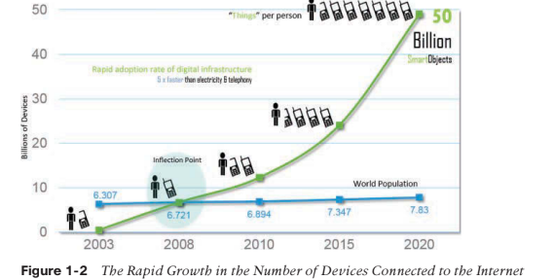
Impact of IoT
Only 40% of the “Things” are inter-connected.
Cisco Systems predicted that by 2020, this number will reach 50 billion.
Helps Managing and monitoring smart objects using real-time connectivity and enables easy data-driven decision making.
This in turn results in the optimization of systems and processes and delivers new services, save time, increase in performance and improve the overall quality of life.

Slide 13
Connected Roadways
Fantasizing about the self-driving car or autonomous vehicle which gets connected and interact with smart transportation infrastructure.
Smart connected roadways, also known as Intelligent Transportation Systems (ITS) or smart highways, utilize advanced technologies to enhance safety, efficiency, and sustainability in transportation infrastructure.
Equipped with:
Smart roads are equipped with sensors. These sensors collect data on traffic flow, vehicle speeds, road surface conditions, weather, and other relevant parameters.
Vehicle-to-Infrastructure (V2I) Communication: Smart roads enable communication between vehicles and infrastructure elements such as wi-fi enabled access points/cellular network, traffic lights, traffic signals, sign boards, road lane. This communication allows for real-time traffic management, optimization of traffic flow, and enhanced safety features like collision avoidance warnings.
Intelligent Traffic Management Systems (ITMS): Smart roads utilize intelligent traffic management systems that analyze data from sensors and cameras to monitor traffic conditions in real-time. These systems can predict traffic congestion, detect incidents, and provide automated responses such as adjusting signal timings, diverting traffic.
Dynamic Lane Management: Smart roads can dynamically adjust lane configurations and markings based on traffic conditions and demand. This flexibility helps optimize lane usage, reduce congestion, and improve traffic flow, especially during peak hours or in areas with variable traffic patterns.
Environmental Monitoring and Mitigation: Smart roads may include environmental monitoring systems to measure air quality, noise levels, and other environmental factors. This data can inform pollution mitigation strategies which helps in urban planning and controlling impact on environment.

Slide 14
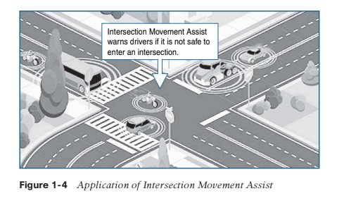
Challenges
Challenges | Support by IOT Connected Roadways
Safety | More crashes and fatalities were reported. anticipate potential crashes(by considering speed of the other vehicles, debris, pits, weather etc) and significantly reduce the number of lives lost each year.
Mobility | Applications can enable system operators and drivers to make more informed decisions, which can, in turn, reduce travel delays by optimizing the routing of the vehicles. –Dynamic rerouting(through GPS communication)
Environment | Public Transportation Association, each year transit systems can collectively reduce carbon dioxide (CO2) emissions-by giving all travelers the real-time information they need and managing the transportation system effectively by reducing traffic jams

Slide 15
Connected Factory
connected smart factories represent the next evolution in manufacturing, offering significant improvements in efficiency, flexibility, and competitiveness in today's rapidly changing industrial landscape.
Key characteristics of a connected smart factory include:
Interconnectedness: Machines, equipment, and systems are interconnected through IoT devices and networks, enabling seamless communication and data sharing.
Data-driven decision-making: The factory collects vast amounts of data from various sources. This data is then analysed using advanced analytics tools to derive insights and form decision-making processes.
Automation and robotics: Connected smart factories leverage automation and robotics to streamline production processes, reduce manual labor and improve consistency in manufacturing, reduction of hazards caused during manufacturing or uplifting any machinery.
Predictive maintenance: By continuously monitoring equipment and machinery performance, smart factories can predict when servicing and maintenance is required for the machines and optimizing maintenance schedules.
Flexibility and agility: Connected smart factories are designed to be adaptable to changing market demands and production requirements. They can quickly reconfigure production lines and processes to accommodate new products or variations.-(This real-time monitoring enables manufacturers to quickly identify bottlenecks, inefficiencies, or deviations from production targets, allowing for prompt adjustments and optimization of production lines.)
Preventive Quality control and line maintenance: Real-time monitoring and analytics enable early detection of defects or deviations from quality standards, allowing for immediate corrective actions to maintain product quality

Slide 16
Smart Building
Buildings have become increasingly complex intersections of structural, mechanical, electrical, and IT components.
The function of a building is to provide a work environment that keeps the person at home or workers at office comfortable, efficient and safe.
Home or Work areas need to be well lit and kept at a comfortable temperature and lighting system.
Detect occupancy - These tend to be motion sensors-Motion detection occupancy sensors work great if everyone is moving around in a room and can automatically shut the lights off when everyone has left-Conserves energy.
Occupancy can also be integrated with HVAC system, where detection of person inside a room automatically regulates air flow and automatic moderate temperature adjustment.
Smart Locking system for safety of the users.
Fire alarm sensor to sense smoke and fire at the time of disaster.
Smart refrigerator-gives the status of freshness of the food items inside it, remind to order or purchase certain food items etc.(recognise food items available and list the recipes on hand

Slide 17
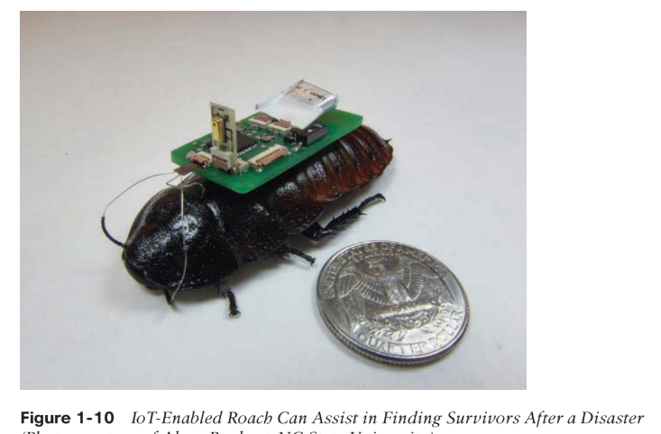
Smart Creatures
Smart electronic backpack on roaches
To help with finding a person trapped in the rubble of a collapsed building.
The electronic backpack is equipped with directional microphones that can detect certain sounds and the direction from which they are coming.

Slide 18
Smart Creatures
Smart sensors in cattles:
Identification Tags: Electronic identification (EID) tags or RFID tags are commonly used to uniquely identify individual cattle within a herd.
Health Monitoring Sensors: Health monitoring sensors measure vital signs such as body temperature, heart rate, and respiratory rate. These sensors can help detect signs of illness or stress early, enabling prompt treatment and preventing the spread of diseases within the herd.
Milk Yield Monitors: In dairy farming, sensors can be used to monitor milk production and milk quality parameters such as fat content and protein content. This information helps dairy farmers to optimise feeding and milk production in cattles.
GPS Tracking: GPS tracking devices are used to monitor the location and movement of cattle, particularly in extensive grazing systems. Farmers can use GPS data to track grazing patterns, monitor herd movements, and prevent theft or predation.
Feed Intake Sensors: These sensors measure the amount of feed consumed by individual cattle or groups of cattle. Monitoring feed intake can help optimize feeding strategies, detect changes in appetite or feeding behavior, and identify health problems such as digestive disorders.

Slide 19
IT and OT
Information Technology
IT data centric and Utility with just computing.
IT typically deals with digital data management, networking, and computing systems, IT refers to the use of computers, storage, networking, and other computing devices to manage and process data.
IT systems are typically used for administrative, communication purpose only.
Examples of IT systems include enterprise resource planning (ERP) software, email servers, and office productivity tools like word processors and spread sheets.
Operational Technology
OT Monitoring and controlling the system computing.
while OT focuses on the hardware and software used to monitor and control physical devices.
OT, on the other hand, focuses on the integration of hardware and ample software systems that detect changes through direct monitoring or through industrial equipment and control those physical devices.

Slide 20
Convergence of IT and OT
Convergence refers to the coming together or integration of different elements, entities, or technologies into a unified whole or common point. It can occur in various contexts, including:
Technological Convergence: This is when different technologies merge or evolve to perform similar functions or operate on similar platforms. For example, the convergence of telecommunications, computing, and media technologies in the form of smartphones.
Media Convergence: This refers to the merging of traditional media forms (such as newspapers, television, and radio) with digital technologies and platforms (like the internet and social media). It involves the integration of content across multiple media channels.
Industrial Convergence: Industries that were once distinct may converge due to technological advancements or changing market dynamics. For instance, the automotive and technology industries are converging with the development of autonomous vehicles and electric cars.

Slide 21
Objectives of convergence of IT and OT
Enhanced Visibility and Insights: Integrating IT and OT systems enables organizations to gather and analyse data from both digital and physical sources, providing deeper insights into operations, performance, and potential areas for improvement.
Real-Time Decision Making: By accessing real-time data from OT systems and integrating it with IT systems, system can make faster and more informed decisions, enabling proactive responses.
Innovation and New Opportunities: The convergence of IT and OT opens up new possibilities for innovation, such as the development of predictive maintenance solutions, smart manufacturing processes, and connected supply chains.

Slide 22
IoT Challenges
While an IoT-enables impressive picture, it does not come without significant challenges.
1) Security
With more “things” becoming connected with other “things” and people, security is an increasingly complex issue for IoT.
The threat surface is now greatly expanded, and if a device gets hacked, its connectivity is a major concern.
A compromised device can serve as a launching point to attack other devices and systems.
2) Privacy
As sensors become more prolific in our everyday lives, much of the data they gather will be specific to individuals and their activities.
This data can range from health information to shopping patterns and payment transactions
For businesses, this data has monetary value.
3) Scale
Devices are getting connected in a larger number and various sector-banking/health science/industry
This means the scale of the network utility has increased.
Challenge is on managing the increasing network usage and security issues within the network.

Slide 23
4) Big Data and Analytics
IoT and its large number of sensors is going to trigger a massive amount of data that must be handled.
This data will provide critical information and insights with various parameter.
The challenge, however, is evaluating massive amounts of data arriving from different sources, in various forms and doing so in a timely and real time manner.
5) Interoperability
various protocols and software architectures are evolving in market share for standardization within IoT.
Some of these protocols and architectures are based on proprietary elements, and others are open.
Proprietary elements are new challenges to the IoT technology in terms of (privacy and security issues, compatibility ,rules and regulatory risk, cost, limited customisation, etc)

Slide 24
IoT Network Architecture
IoT Network architecture refers to the design and structure of a IoT network.
It encompasses various components, protocols, and technologies that define how devices communicate and exchange data within the network.
Network architecture plays a crucial role in ensuring the efficient, secure, and reliable operation of a network.
IoT is different technology than existing IT Technology and thus, requires new IoT architecture models.

Slide 25
IoT Architectural Drivers
Scale- The massive scale of IoT endpoints - The IPv4 address space has reached exhaustion and is unable to meet IoT’s scalability requirements (IPv6 and NAT technology)
Security- IoT devices, especially those on wireless sensor networks (WSNs), are often physically exposed to the threat world (modification to design of an existing network with a primary focus on implementing robust security measures to protect against various cyber threats and vulnerabilities)
Constrained Devices and Networks – Due to devices constrained by power, CPU, memory and speed and bandwidth network are always lossy and supports minimal data rates- wireless technologies are needed upgrade in network and transport layer to support constrained IoT devices over long distances.

Slide 26
Data Analytics- The sensors generate a massive amount of data on a daily basis, causing network bottlenecks and slow analytics in the cloud- Data analytics capabilities need to be distributed throughout the IoT network, from the edge to the cloud.(Analytics refers to the systematic analysis of data or statistics to uncover meaningful patterns-It involves applying various techniques, methods, and tools)
The need for data to be processed in real time- Whereas traditional IT networks perform scheduled batch processing of data, IoT data needs to be analyzed and responded to in real-time- Analytics software and processing needs to be positioned closer to the edge and should support real time processing.
Support for legacy devices-An IoT network often comprises a collection of modern, IP-capable endpoints as well as legacy, non-IP devices- Integrating IoT with legacy systems can be challenging due to differences in technology, protocols, and data formats (upgradation in data normalisation, gateways, transmission network, middleware platform,etc)

Slide 27
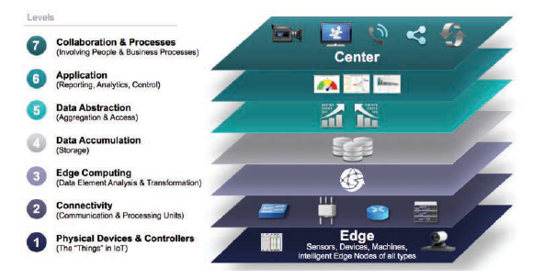
The IoT World Forum (IoTWF) Standardized Architecture
the IoTWF architectural committee published a seven-layer IoT architectural reference model.
While various IoT reference models exist, the one put forth by the IoT World Forum offers a clean and simplified perspective on IoT.

Slide 28
Perception/ Physical Layer: The Perception Layer is the lowest layer of the IoT reference model and represents the physical world where sensors, actuators, and other IoT devices collect data from the environment. This layer is responsible for sensing and capturing real-world data such as temperature, humidity, motion, and location.
Connectivity Layer: The Connectivity Layer is responsible for transporting data collected by IoT devices to the next layer of the IoT architecture, typically through wired or wireless communication networks. This layer concentrate on protocols, standards, and technologies for connecting IoT devices to the internet and other network infrastructure.
Edge computing (Edge Server): in IoT refers to the practice of processing data closer to the source of generation, typically at or near the edge of the physical network, rather than relying solely on centralized cloud computing resources. In edge computing, data is processed locally on IoT devices, gateways, or edge servers, before being transmitted to the cloud or data center for further analysis or storage.

Slide 29
Purpose of Edge Computing
Reduced Latency: By processing data locally at the edge of the network, edge computing reduces the latency associated with transmitting data to centralized cloud servers for processing. This is particularly important for applications that require real-time or low-latency processing.
Bandwidth Optimization: Edge computing helps optimize network bandwidth by reducing the amount of data that needs to be transmitted to the cloud. By processing data locally and transmitting only relevant or aggregated data to the cloud, edge computing minimizes network congestion.
Improved Privacy and Security: Edge computing enhances data privacy and security by processing sensitive data locally on IoT devices or edge servers, rather than transmitting it over potentially insecure network connections to centralized cloud servers.
Resilience and Reliability: Edge computing improves the resilience and reliability of IoT systems by enabling local processing and decision-making capabilities, even in the absence of network connectivity or during network outages. This ensures that critical functions can continue to operate autonomously at the edge, without relying on continuous access to cloud services

Slide 30
Data Accumulation (Storage): The cloud plays a significant role in IoT (Internet of Things) deployments by providing a scalable, flexible, and centralized platform for storing, processing, and analyzing data generated by IoT devices.
Purpose of Cloud:
Data Storage: The cloud serves as a reliable, scalable and centralized repository for storing large volumes of data generated by IoT devices.
Data Processing: The cloud provides powerful computing resources for processing and analyzing large volume of IoT data in real-time by using big data analytics platform on the stored data.
Security: Cloud providers offer robust security measures, data encryption, protect IoT data and applications from unauthorized access, data breaches, and cyber threats
Device Management: Cloud-based device management platforms enable organizations to remotely monitor, manage, control and update the gathered data at scale

Slide 31
Data Aggregation: Data aggregation simplifies and condenses the information into more manageable and meaningful forms. Data aggregation summarises data points for the purpose of reporting and visualisation. (Sampling, grouping, counting, averaging etc)
Application : The application layer in IoT serves as the interface between IoT devices and end-users. Proactive monitoring, controlling and timely response to critical events is achieved here through actuators or application software.
Collaboration: Data sharing among various entities like stake holders, business sector etc for constant upgradation of iot services, analyzation and management of data gathered and operation performed.

Slide 32
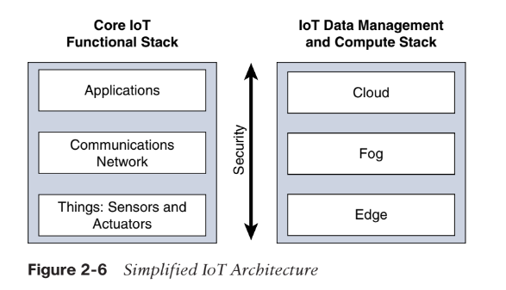
Simplified IOT Architecture
The IoT technology core stack is a spectrum of technologies, standards and applications designed to connect devices to the Internet to collect data from them for different purposes.
Data management and compute stack Includes data framework and virtual layer elements.

Slide 33
Simplified and IOTWF Architecture
Standardization and Frameworks
Simplified IoT Architecture: It may not adhere strictly to any specific IoT standard or framework but rather provides a generic template that can be adapted and customized according to specific needs.
IoTwf IoT Architecture: The IoTWF architecture is likely to incorporate standards, best practices, and guidelines established by the Internet of Things World Forum. It may provide a structured framework for designing, implementing, and managing IoT solutions, promoting interoperability and scalability across different domains and industries.

Slide 34
Interoperability and Ecosystem Integration
Simplified IoT Architecture: While interoperability is important, the simplified architecture may not delve deeply into standards and protocols for seamless integration between diverse devices, platforms, and ecosystems.
IoTwf IoT Architecture: The IoTwf architecture may place greater emphasis on interoperability, emphasizing the need for standardized protocols, interfaces, and data models to facilitate seamless communication and collaboration within the IoT ecosystem.

Slide 35
Complexity and Scope:
Simplified IoT Architecture: The simplified IoT architecture provides a high-level overview of the essential components involved in an IoT system, focusing on the basic functionalities and interactions between devices, connectivity, cloud platforms, analytics, and user interfaces.
IoTwf IoT Architecture: The IoTwf IoT architecture, developed by the Internet of Things World Forum, is likely to be more comprehensive and detailed. It may include additional components, layers, and standards specific to the IoTwf framework,

Slide 36
M2M IoT Architecture
The European Telecommunications Standards Institute (ETSI) created the M2M Technical Committee in 2008. The goal of this committee was to create a common architecture that would help accelerate M2M applications and devices.
In 2012 ETSI and 13 other inventive bodies launched oneM2M as a global initiative designed to promote efficient M2M communication systems and IoT.
The goal of oneM2M is to create a common services layer, which can be readily embedded in field devices to allow communication with extensive application like smart metering applications, smart grid, smart city automation, e-health, and connected vehicles.
One of the stated goals of oneM2M is to “develop technical specifications which address the need for a common M2M Service Layer that can be readily embedded within various hardware and software nodes,

Slide 37
The oneM2M architecture divides IoT functions into three major domains: the application layer, the services layer, and the network layer.
Applications layer: The oneM2M architecture gives major attention to connectivity between devices and their applications.
This domain layer includes the standard optimised application-layer protocols, data models and attempts to standardize API definitions for interaction with various system.
Service Layer: they are like middlewear components which facilitates communication and data exchange. One of the stated goals of oneM2M is to “develop technical specifications which address the need for a common M2M Service Layer that can be readily embedded within various hardware and software nodes.
Network layer: This is the communication domain for the IoT devices and end points. It includes the devices themselves and the communications network protocols, gateways and frameworks that link them. concerned on improvising connectivity technologies Bluetooth, Zigbee, cellular networks and wired connections such as Ethernet.

Slide 38
The IoT technology stack is nothing else than a range of technologies, standards and tools, which lead from the simple connection of objects to the applications that use these connected things, the data they gather and communicate and the different steps needed to power them.

Slide 39
Layer 1: Physical Layer
Most IoT networks start from the object, or “thing,” that needs to be connected.
From an architectural standpoint, the variety of smart object types, shapes, and needs drive the variety of IoT protocols and architectures.

